Slide 1

Quality Assurance 101
Brought to you by the QA team: Liz Dzabic, Quality Assurance Coordinator; John Ragan, Quality Assurance Auditor
September 20, 2013

Slide 2
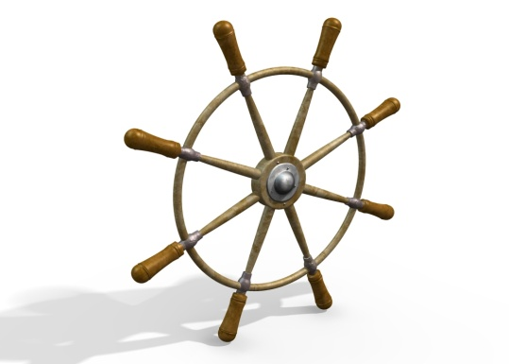
We Will Cover Today . . .
Part I. Quality Assurance at CCCOnline: Overview
  “All hands on deck” at CCCO
  Goals of our QA program
Timeline of Quality Assurance reviews
Evaluation path, contesting evaluation, support
Part II. Activity: Quality Assurance
evaluations

Slide 3
A Quality Online Course Will
  Be designed well with efficient navigation (course design / instructional design & delivery)
  Assess and evaluate learning clearly
  Provide learner support & resources
  Use technology appropriately (use of tools/LMS capabilities supports & enhances learning objectives)
  Foster student interaction/engagement
    Quality Matters: http://www.qmprogram.org/
    Blackboard Exemplary Course Program Rubric: http://www.blackboard.com/getdoc/7deaf501-4674-41b9-b2f2-554441ba099b/2012-Blackboard-Exemplary-Course-Rubric.aspx
    Rubric for Online Instruction (ROI) from California State U-Chico: http://www.csuchico.edu/celt/roi/index.shtml

Slide 4
Our Collaborative Approach
Be designed well with efficient navigation
Assess & evaluate learning clearly
Use technology appropriately
Foster student interaction / engagement
Provide learner support & resources
Instructional Design Team
Academic Team
Academic, Academic Tech, & Student Services Team
Academic Tech, Instructional Design, Academic Team
QA, Academic Team, Training
A quality course will
CCCOnline Teams

Slide 5
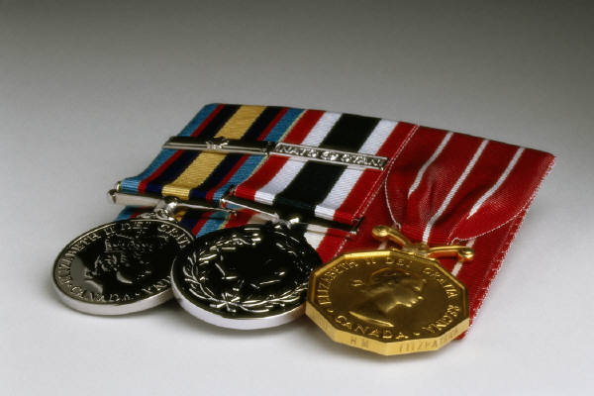
CCCO’s Quality Assurance Program Goals
Encourage excellence in online classrooms
Foster consistency across courses
Provide documentation for Chairs & Associate Deans to advise instructors
  Areas for improvement
  Exemplary teaching

Slide 6
Before the Semester Starts
First-day checks
Program Chairs perform these checks
Every course reviewed
Corresponds to Course Readiness Checklist
Communication between instructors and Chairs is essential

Slide 7
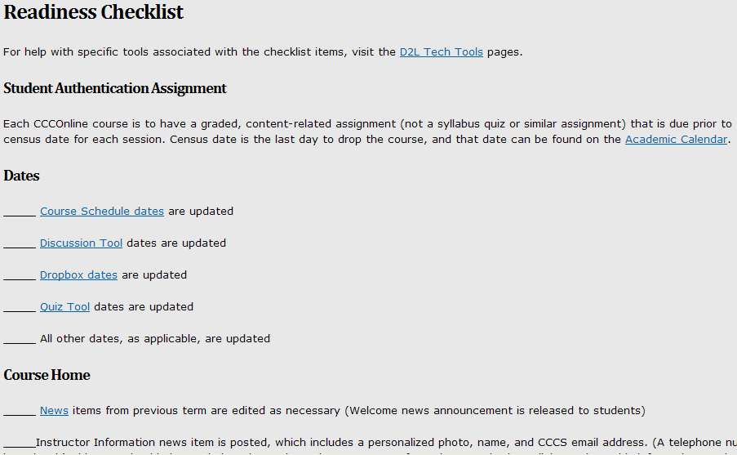

Slide 8

Start of the Semester
Administrative reviews for new instructors
Correspond to Threaded Discussion QA Rubric

Slide 9
During the Semester
Full Quality Assurance evaluations
For every instructor once/year
  New instructors: evaluated first two semesters
  Instructors with N mark(s) evaluated the following semester
  Chairs’ special requests evaluated
Corresponds to Threaded Discussion QA Rubric

Slide 10
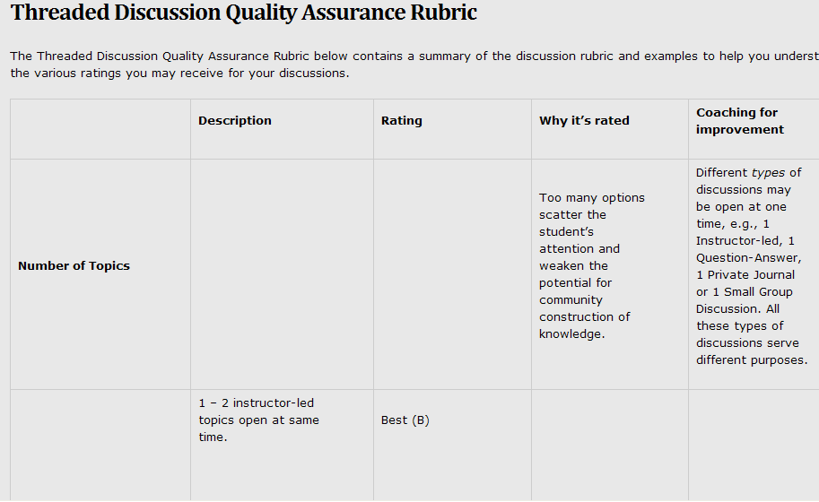

Slide 11
Evaluation Path (for both administrative & full QA reviews)
1
Quality Assurance Evaluation
2
Program Chair
3
Instructor
Associate Dean

Slide 12
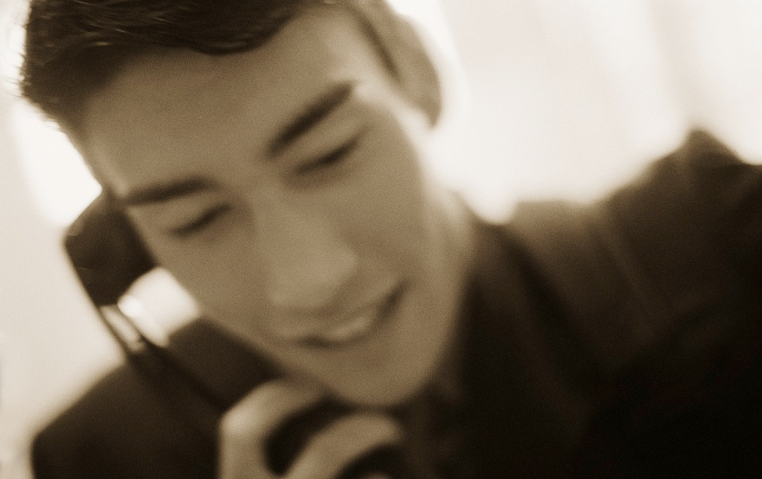
Contesting an Evaluation
Conversation between Quality Assurance staff and Program Chair and/or Dean
When evaluation includes low marks (scores of N):
Follow-up mentoring

Slide 13

Support for Instructors
CCCOnline Instructor Handbook (Discussion)
CCCOnline Training & Professional Development (“Managing Discussions” workshop, webinars)
Ongoing coaching and support from
Associate Deans and/or
Program Chairs

Slide 14

Quality Assurance Activity
Samples originated from our classes
Short excerpts from discussions to give you a rough idea of the evaluation process

Slide 15
Qualitative Criterion on Rubric
Interaction Quality
  Best (B): Instructor regularly interacts with all learners in class, both on an individual and a group basis.
  Good (G): Instructor does acknowledge and validate posts, but in a less than substantial way, and/or may not consistently include all class participants and their concerns.
  Needs Improvement (N): Instructor regularly responds to only a select few individuals; may not answer all learner questions and/or responses only affirm that instructor reads student posts.

Slide 16
Qualitative Criterion on Rubric
Acknowledgement
  Best / Good (B / G): Instructor posts regularly acknowledge learners' understanding of content.
  Needs Improvement (N): Little or no acknowledgement is made of learners' understanding of content.

Slide 17
Qualitative Criterion on Rubric
Additional Posts
  Best / Good (B / G): Instructor posts regularly add additional information and direct or re-direct the discussion or appropriately close it.
  Needs Improvement (N): Instructor posts do not regularly further the discussion or appropriately close it.

Slide 18
Qualitative Criterion on Rubric
Engagement/Re-Engagement
  Best (B): Instructor posts regularly re-engage individual learners as well as the entire class through the use of additional questions at the same or higher level.
  Good (G): Instructor posts regularly re-engage learners through additional questions at the same or higher level.
  Needs Improvement (N): Limited or no re-engagement occurs.

Slide 19
Let’s Look at the Following Excerpts for . . .
Interaction Quality
Acknowledgement
Additional Posts
Engagement/Re-Engagement
Classes: U.S. History & Fundamentals of Mathematics (MAT 030)

Slide 20
Subject: Re: Puritans and The Great Awakening
Author: Cecily Student
The Puritans were a group of people that were dissatisfied with and wanted to purify the Church of England and reform society, religion and morals. The Great Awakening was a period of religious "revivals" in places such as America, England, Germany and Scotland and has been said to be the most important event in the history of religion.
Resources:
http://www.nd.edu/~rbarger/www7/puritans.html; http://www.digitalhistory.uh.edu/database/article_display.cfm?HHID=687
A. (Instructor Response)
Hi Cecily,
What were the revivals like?
***********************************************************************
Subject: Re: Puritans and The Great Awakening
Author: Jack Student
The Great Awakening made a lot of people realize that your own individual beliefs are a little more important than a set religion. It allowed people to override what the church was telling them to do and instead focus on what they thought their god would want them to do.
B. (Instructor Response)
Hi Jack,
Who were some of the leaders of this movement and what are some examples of their messages?
***********************************************************************

Slide 21
Subject: Re: Puritans and The Great Awakening (the first)
Author: Algernon Student
Oops. I forgot to add about the Halfway Covenant. The Halfway Covenant was an idea created by
Puritan ministers that was an attempt to increase membership in the church. Decline in conversions
had been cause by less people testifying to "saving grace" experiences. The Halfway covenant did
succeed in a greater amount of people converting, but it removed the purity that the Puritans had
when the only method to obtain membership was a testimony of direct contact with God. The
Halfway Covenant allowed people to convert to members of The Church, but restricted them from
having the same rights to communion. Children of those converted under the Halfway Covenant,
were automatically granted full membership, even if they lacked Baptism.
C. (Instructor Response)
Hi Algernon and class,
What does this tell you about the view of religion and the youth?
***********************************************************************
Subject: Re: Puritans and The Great Awakening
Author: Gwen Student
The Great Awakening was also one of the major causes of the Revolution. The colonists realized
that they wouldn't be able to practice religious freedom while being ruled by the Church of England
and the King. There were many other factors that lead to the Revolution, but religious freedom was
one of the major factors that changed the history of the world and created the United States.
D. (Instructor Response)
Hi Gwen and class,
The enlightenment and the Great Awakening were certainly contributing factors to the
movement away from Colonial Life to a new nation. Class, what was the enlightenment
period about and how would that affect people's beliefs?
***********************************************************************

Slide 22

Moving into the Other Class. . .
What differences might you expect to see in a developmental-level Math discussion?
Same QA criteria apply:
Interaction Quality
Acknowledgement
Additional Posts
Engagement/Re-Engagement
Notes:
Math in general: object is to solve problems and move on – so, not necessarily the same amt of re-engagement (other than at the clarification “how did you get that?” level)…dev-ed– lots of encouragement/acknowledgement, whereas that isn’t AS prominent in college-level classes

Slide 23
Subject: Unit G Discussion
Author: Peyton Student
A flight from Boston to Pittsburgh takes 2 hours and 35 minutes. How many minutes long is the flight?
To slove this problem we need to first convert hours into minutes.
1 hour=60 minutes
Therefore, 2 hours=120 minutes
Now we just need to add.
120+35=155 minutes
A flight from Boston to Pittsburgh is 155 mintues long.
A. (Instructor Response)
Peyton - Thanks for explaining the problem with every detail. This is one type of problem that will be used quite a bit in algebra.
***********************************************************************
Subject: Unit G Discussion
Author: Tim Student
3.4 tons of bananas are off-loaded from a ship that has just arrived from Costa Rica. The port taxes imported fruit at $0.015 per pound. What is the tax on the entire shipment?
First thing that you have to figure out is how many pounds that you have. So you would multiply the 3.4 tons by 2000 pounds. Because there are 2000 pounds in 1 ton.
3.4×2000=6800/ Next you multiply the 6800 pounds of bananas by the $0.015 per pound tax. / 6800×$0.015=$102.00 / So the total port tax due on these bananas is $102.00.
B. (Instructor Response)
Tim -I love your logical approach to the problem. One great thing about working math problems...multiple ways to work them.
Another approach using the information you provided:
3.4tons⋅2000lb1 ton⋅$0.0151 lb
Once we simplify the tons and lbs we are left with....
2000 * 0.015 = $102
***********************************************************************

Slide 24
Subject: Unit G Discussion
Author: Drew Student
Converting 38 ft/sec to m//sec 38ftsec×305 ft1m=11.59m/sec In doing this there are two steps to follow: 1) Find the equivalent measure that begins with the unit and ends with the unit you want. 2) Multipl by the unit fraction.
C. (Instructor Response)
Drew - when I do the math in your problem I am not getting the same answer you have. Please revise....
***********************************************************************
Subject: Unit G Discussion
Author: Aaron Student
The world's highest dam, the Rogun dam in Tajikistan, is 335 meters high. How many kilometers high is the dam?
To convert meters to kilometers we need to know that 1 meter is equal to 0.001 kilometers.
So, 335 meters would be 0.335 kilometers
How I did this was by moving the decimal point to the left three spaces or
multiply 335m X 0.001km=0.335km
D. (Instructor Response)
That is correct Aaron :)
There is a saying to help remember the order:
Kelly Hurriedly Drew Monkeys During Class Monday
km hm dam m dm cm mm
Since we are moving from m to km we go 3 to the left...moving the decimal point to the left three spaces.
***********************************************************************

Slide 25

Questions?
Keep in touch with your Chair and Associate Dean
Thank you for your
participation!

